Slide 1
Bringing ML to Mobile Apps – Let’s build an app to perform Face Recognition using Flutter
Don Ward
Quicken Loans
Senior Research Engineer
donward@quickenloans.com
@donwardpeng

Slide 2
Who should be here?
Notes:
Know a programming language.
People who enjoy curly braces.
No authors
No need to have done mobile.
Admin access on PC.
Have heard of Flutter, but want to learn it.

Slide 3
The Agenda
Flutter
What, why, how
Dart
What, why, how
What are we building today?
What does it use?
Let’s setup our environments!

Slide 4
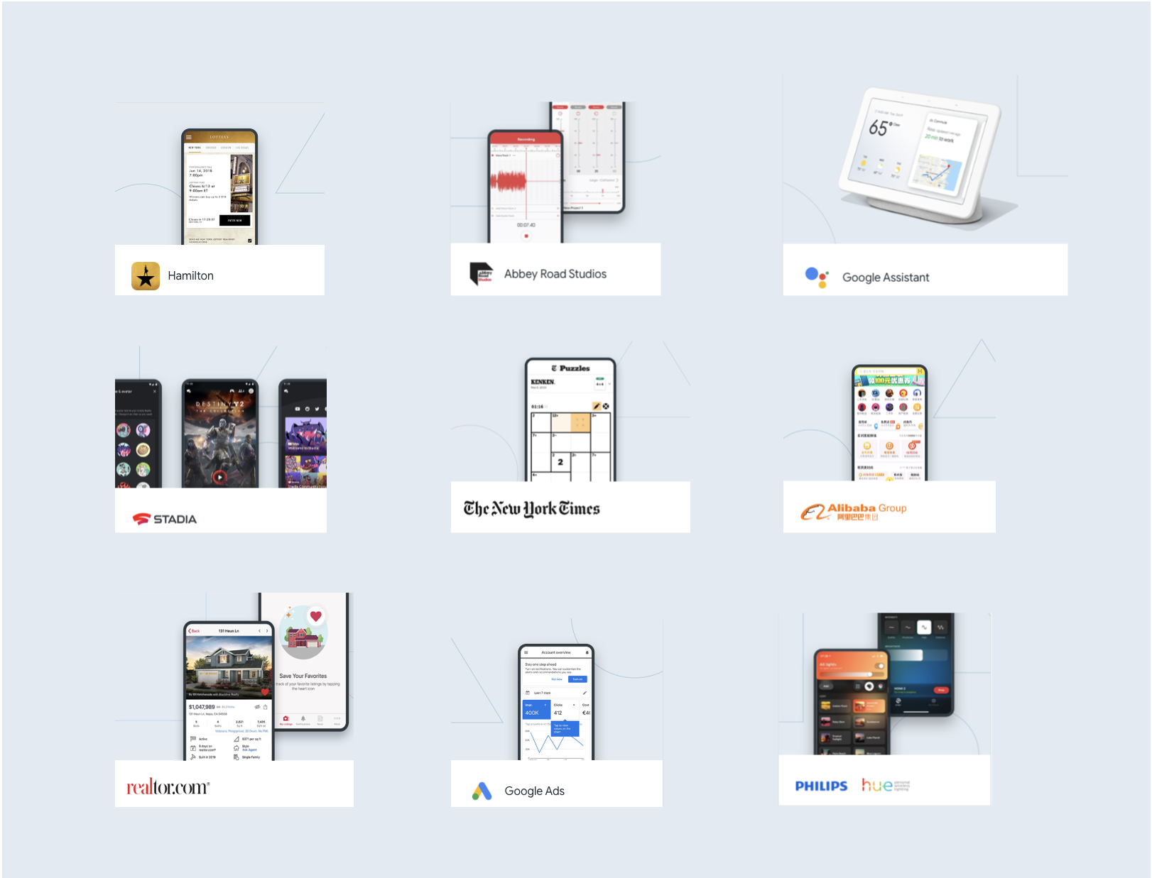

Slide 6
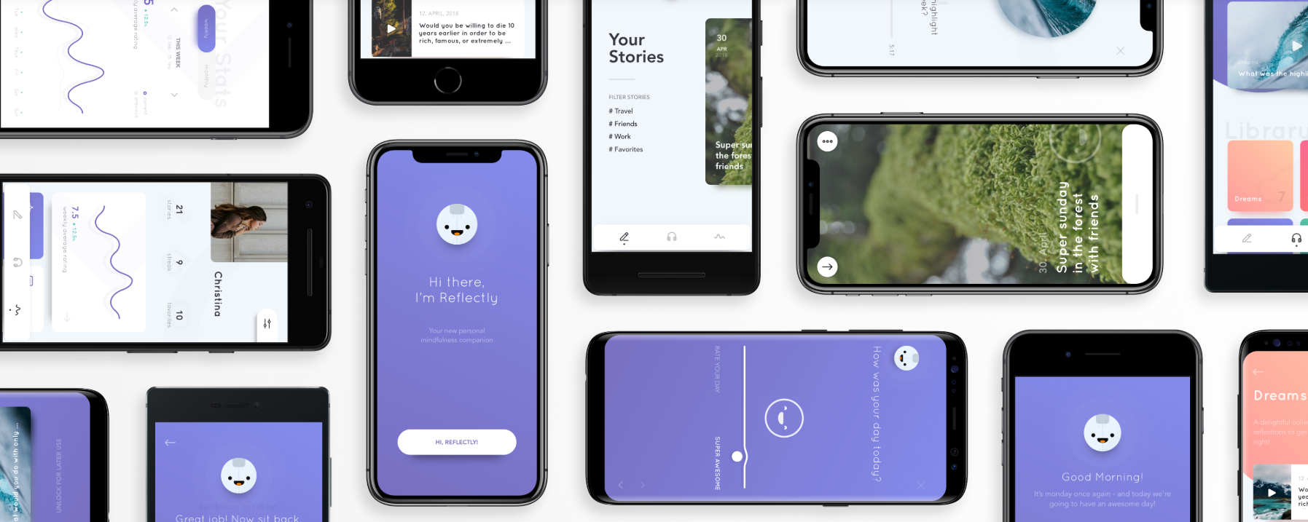

Slide 7
new Center( child: new Column( children: [ new Text('Hello, World!')), new Icon(Icons.star,
color:Colors.green) ] ) )

Slide 9
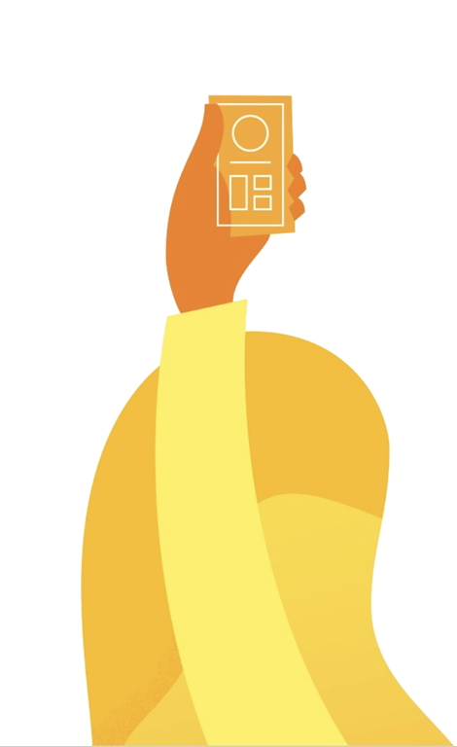
‘Why Flutter?’

Slide 10
Native Apps

Slide 11
PhoneGap, Cordova, and WebView based Systems

Slide 12
React Native

Slide 13
Flutter

Slide 14
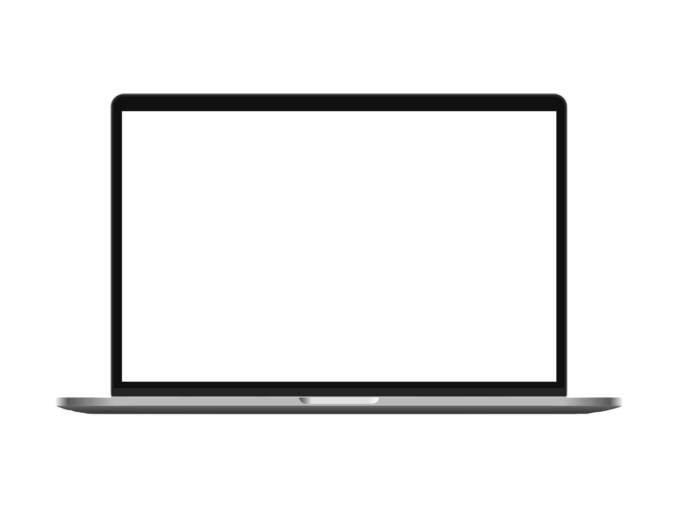


Slide 15
‘Why Dart?’

Slide 16
Need next slide!

Slide 17
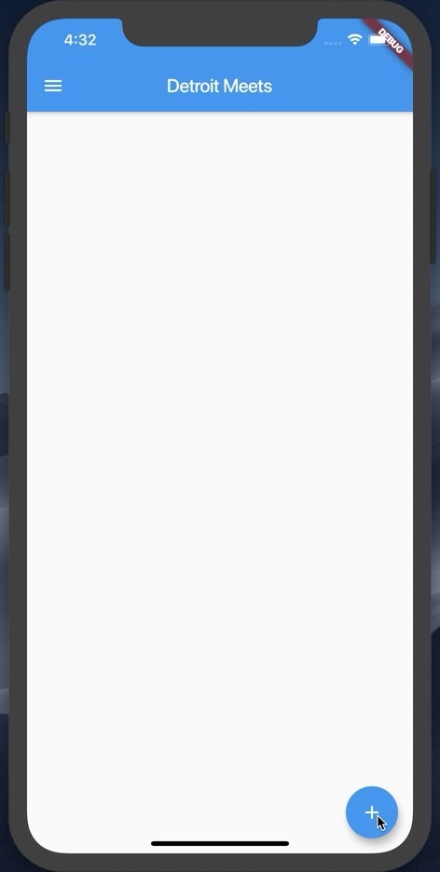
What are we building today?

Slide 18
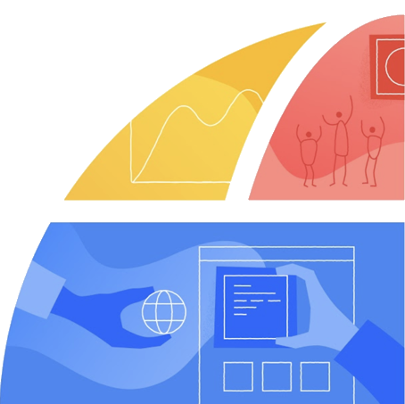
Let’s setup your environment!

Slide 20
Let’s start
Flutter SDK installed
Visual Studio Code installed
Android emulator or iOS simulator running
http://bit.ly/detroitmeetsflutter

Slide 21
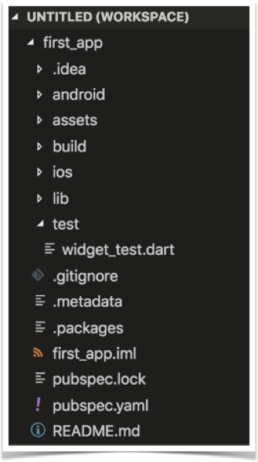
Project Structure

Slide 22
Let’s start from scratch
In VS Code, open the main.dart file
Wipe it clean
Add the code below
//Example 1
import 'package:flutter/material.dart';
void main() {}

Slide 23
Let’s attach something to the screen
The runApp method
In Dart, ‘=>’ is equivalent to {return expr};
//Example 2
import 'package:flutter/material.dart';
void main() => runApp(<Widget>);

Slide 24
‘Let’s talk about Widgets’

Slide 25
Widgets
Everything is a widget
Stateless Widgets
Stateful Widgets
class StatelessWidgetExample extends StatelessWidget{};
class StateFullWidgetExample extends StatefulWidget{};

Slide 26
Let’s create our first Widget
//Example 3
import 'package:flutter/material.dart';
void main() => runApp(MyApp());
class MyApp extends StatelessWidget{
@override
Widget build(BuildContext context) {
// TODO: implement build
return null;
}
}

Slide 27
Let’s add some Material Design
//Example 4
@override
Widget build(BuildContext context) {
return MaterialApp(
title: ‘CUCSC Conference’,
);
}
}

Slide 28
‘Exciting Stuff! Let’s talk about Constructors!’

Slide 29
Widgets & Constructors
Positional and Named Parameters
Named Parameters declared with {}

Slide 30
The Text Widget
Text(String data, { Key key, TextStyle style, StrutStyle strutStyle, TextAlign textAlign, TextDirection textDirection, Locale locale, bool softWrap, TextOverflow overflow, double textScaleFactor, int maxLines, String semanticsLabel })

Slide 31
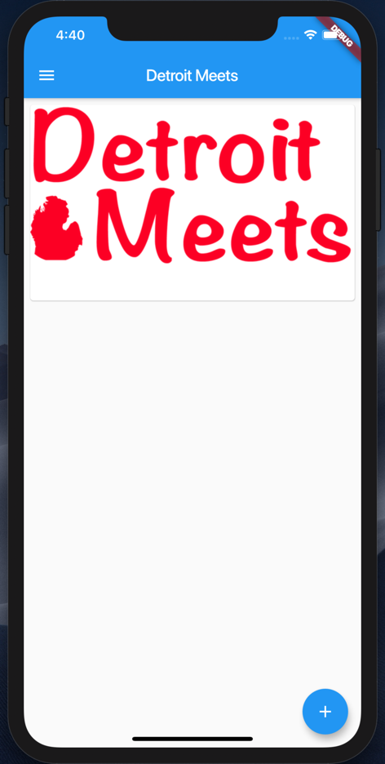
Let’s add some Widgets
Add a Card per Image
Add a Floating Action Button

Slide 32
Add a Scaffold for the Screen
//Example 5
return MaterialApp(
title: Detroit Meets',
home: Scaffold(
appBar: AppBar(
title: Text(‘Detroit Meets'),
),
));

Slide 33
Add a Card to the Body
//Example 6
home: Scaffold(
appBar: AppBar(title:Text(‘Detroit Meets’),),
body: Card(child: ,));
}
}

Slide 34
Add a Column to the Card
//Example 7
... appBar: AppBar(
title: Text(‘Detroit Meets’),
body: Card(child: Column(children: <Widget>[],),
),
));
}...

Slide 35



Let’s add some images
Steps:
Create a new assets folder and add images
Modify pubspec.yaml file

Slide 36
Add a Image to the Card
//Example 8
...
child: Column(
children: <Widget>[
Image.asset(‘assets/detroit_meets.jpeg'),
],
),...

Slide 37
Guess what – Padding is a Widget
//Example 9
Below the Image...
Padding(padding: const EdgeInsets.all(8),
),
],
),
)));...

Slide 38
Margin is inside a Widget
//Example 10
...
body: Card(
margin:EdgeInsets.all(8),
child: Column(
children: <Widget>[
Image.asset(‘assets/detroit...'),
...

Slide 39
ListViews give us scroll
//Example 11
...
body: ListView(
children: <Widget>[
Card(
margin: EdgeInsets.all(8),
child: Column(
...

Slide 40
Let’s add a Floating Action Button
//Example 12
...
body: ListView(children: <Widget>[
...
floatingActionButton: ,));

Slide 41
Let’s add a FAB object
//Example 13
...
floatingActionButton: FloatingActionButton(
child: const Icon(Icons.add),),
));

Slide 42
onPressed() for the FAB
//Example 14
floatingActionButton: FloatingActionButton(
child: const Icon(Icons.add),
onPressed: () {}),
));

Slide 43
Everything is in place now. Let’s wire up the button and images to the list.
WARNING: BOILERPLATE CODE AHEAD

Slide 44
Let’s add a list of Images
//Example 15
class MyApp extends StatelessWidget {
// Declare a set list of images to cycle through
final List<Image> _itemImages = [
Image.asset('assets/detroit_cityscape.jpg'),
Image.asset('assets/detroit_meets.jpeg'),
Image.asset('assets/tigers-d.jpg')
];
int _index = 0;
List<Image> _listOfImagesForScreen = [];

Slide 45
Boiler Plate Alert – A Stateful Class
//Example 16
class MyApp extends StatefulWidget {
@override
State<StatefulWidget> createState() {
return _MyAppState();
}
}
class _MyAppState extends State<MyApp> {

Slide 46
Let’s make the button do something
//Example 17
//Add to the main class above the build method
void onButtonPressed() {
setState(() {
_index++;
if (_index >= _itemImages.length) {
_index = 0;
}
_listOfImagesForScreen.add(_itemImages[_index]);
})}

Slide 47
Update the ListView
//Example 18
home: Scaffold(
appBar: AppBar(
title: Text('Detroit Meets'),
),
body: ListView(
children: _listOfImagesForScreen
.map((element) => Card(
margin: EdgeInsets.all(8),

Slide 48
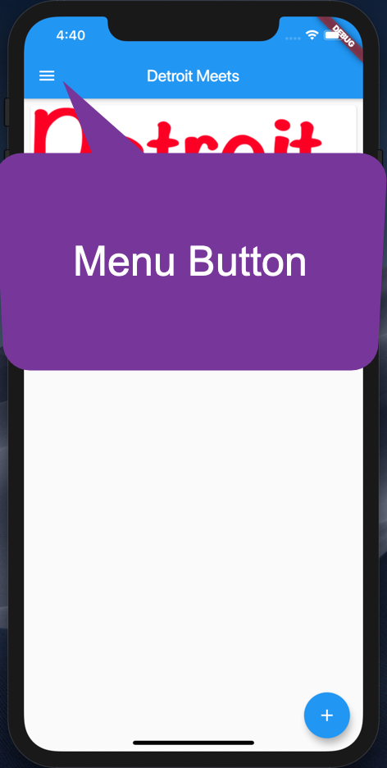
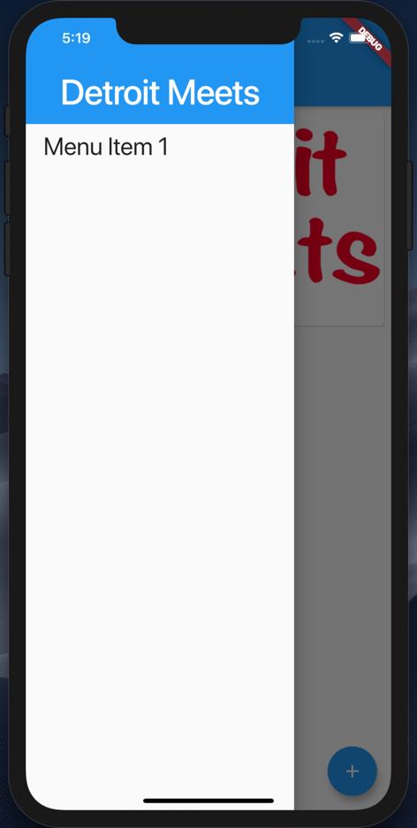
Let’s add a Nav Drawer

Slide 49
A simple Nav Drawer
//Example 19
drawer: Drawer(
child: ListView(
padding: EdgeInsets.zero,
children: <Widget>[
Container(
height: 128.0,
child: DrawerHeader(
child: Text(
'Detroit Meets',
...

Slide 50
What did we learn?
Command Line Tool for Flutter
Project Structure
Widgets
Constructors and Named Parameters
Stateless and Stateful Widgets
A few Widgets ☺
http://bit.ly/detroitmeetsflutter

Slide 51

Thank you!
Don Ward
Quicken Loans
Senior Research Engineer
donward@quickenloans.com
@donwardpeng

